Slide 1
Requirement Engineering Functional vs. Non-functional Requirements, Gathering Techniques and Use Case Modeling

Slide 2
Objectives
Understand the basics of requirement engineering.
Differentiate between functional and non-functional requirements.
Explore various requirement gathering techniques.
Learn how to use case modeling to capture requirements.

Slide 3
Introduction to Requirement Engineering
Requirement engineering is the process of eliciting, documenting, validating, and managing software requirements.
Importance:
Ensures customer needs are met.
Reduces ambiguity and project risks.
Forms the foundation for design and development.
Key Steps:
Requirement Elicitation
Requirement Analysis
Requirement Specification
Requirement Validation

Slide 4
Functional vs. Non-Functional Requirements
Functional Requirements:
Define specific behavior or functions of the system.
Examples:
"The system shall allow users to login."
"The software shall generate monthly reports."
Non-Functional Requirements:
Define system properties, constraints, or quality attributes.
Examples:
"The system shall respond within 2 seconds."
"The application must support 1000 concurrent users."

Slide 5
Comparison Table:
Criteria | Functional Requirements | Non-Functional Requirements
Focus | What the system does | How the system performs
Example | Login functionality | Performance, security, reliability
Validation | Testable using functional tests | Measured using performance tools

Slide 6
Importance of Requirements
Provides clarity to stakeholders.
Forms the basis for testing and validation.
Reduces development rework.
Ensures project scope is well defined.
Common Challenges:
Unclear or changing requirements.
Miscommunication between stakeholders .
Balancing functional and non-functional needs.

Slide 7
Requirement Gathering Techniques
Interviews:
Conduct structured or unstructured conversations with stakeholders.
Advantages: In-depth insights, tailored questions.
Disadvantages: Time-consuming, stakeholder bias.
Surveys/Questionnaires:
Distribute a list of predefined questions to a large audience.
Advantages: Cost-effective, gathers quantitative data.
Disadvantages: Limited depth, low response rates.
Workshops:
Collaborative sessions with multiple stakeholders.
Advantages: Consensus building, real-time discussions.
Disadvantages: Requires facilitation, scheduling challenges.

Slide 8
Best Practices for Requirement Gathering
Involve all stakeholders early and frequently.
Ask open-ended questions to gather detailed inputs.
Use visual aids (diagrams, mockups) to clarify understanding.
Document all discussions and validate requirements.
Prioritize requirements using MoSCoW (Must-have, Should-have, Could-have, Won't-have).

Slide 9
Introduction to Use Case Modeling
Definition: Use case modeling is a technique to describe system behavior using actors and use cases.
Components:
Actor: Represents users or systems interacting with the system.
Use Case: Describes a specific functionality or goal.
System Boundary: Defines the scope of the system.
Relationships: Includes, extends, and generalizes use cases.

Slide 10
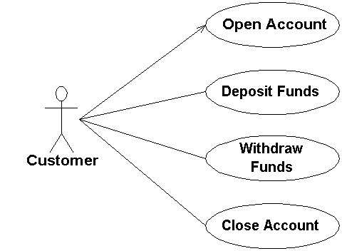

Slide 11
Use Case Diagram Notation
Actors: Stick figures representing users.
Use Cases: Ovals representing system functionalities.
Relationships:
Association: Solid line between actors and use cases.
Include: Dotted arrow labeled «include» for mandatory behavior.
Extend: Dotted arrow labeled «extend» for optional behavior.
System Boundary: Box enclosing the use cases.
Example:
Scenario: Library Management System
Actors: Librarian, Member
Use Cases: Issue Book, Return Book, Add Book

Slide 12
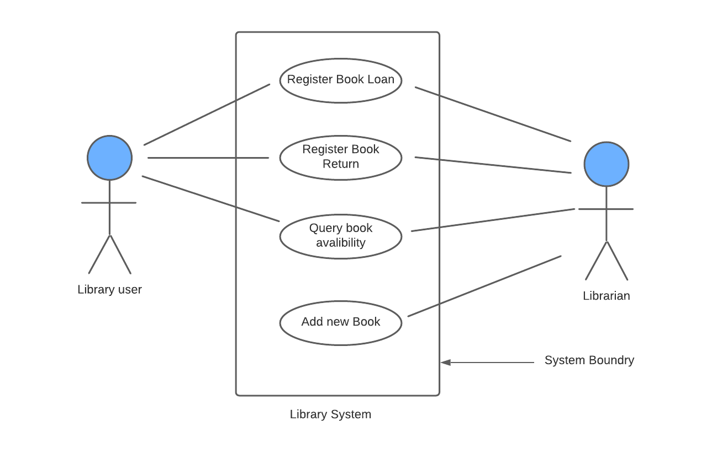

Slide 13
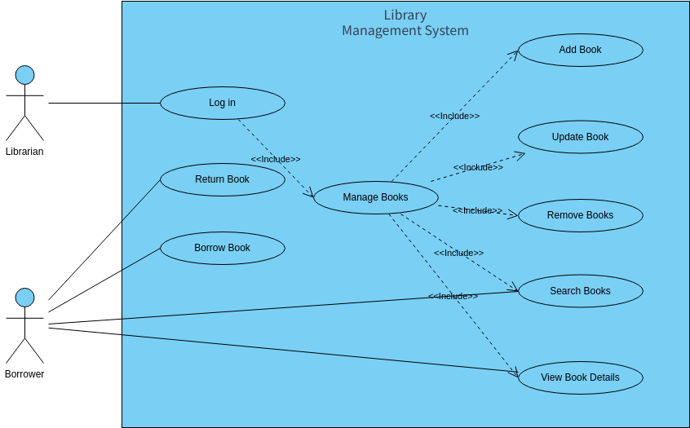

Slide 14
Creating a Use Case Model
Identify Actors: Who interacts with the system?
Identify Use Cases: What are the functionalities or goals?
Define Relationships: How do actors and use cases relate?
Draw the Diagram: Use UML notations to represent components.
Example:
Actors: Student, Teacher
Use Cases: Submit Assignment, Grade Assignment
Relationships: Teacher «includes» Login, Student «extends» Upload File.

Slide 15
Advantages of Use Case Modeling
Simplifies requirement understanding for stakeholders.
Provides a clear, visual representation of system functionality.
Helps identify missing requirements early .
Bridges the gap between requirement gathering and system design.

Slide 16
Summary
Requirement Engineering: Ensures system requirements are gathered, analyzed, and validated.
Functional vs. Non-Functional: Functional requirements define what the system does, while non-functional define how the system performs.
Gathering Techniques: Interviews, surveys, and workshops help elicit requirements.
Use Case Modeling: Captures functional requirements visually using diagrams.

Slide 17
References
Software Engineering: Ian Sommerville
UML Distilled: Martin Fowler
Online resources: TutorialsPoint, GeeksforGeeks

